Slide 1
11-14th April 2018
Melbourne Convention and Exhibition Centre

Slide 2
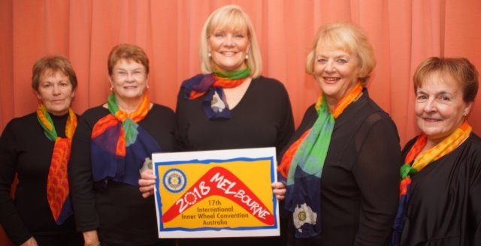
IIW 2018 Convention Committee
From left to right:
Pam Watkins Home Hosting Coordinator
Lorraine Hyde Convention Treasurer
Val Corva Convention Coordinator
Margaret Sansom Deputy Chief Steward
Anne Mc Gill Chief Steward

Slide 3
Melbourne Convention and Exhibition Centre and Hilton Melbourne South Wharf Hotel

Slide 4
Melbourne Convention and Exhibition Centre and South Wharf precinct
Our Convention ‘home’ for all events.

Slide 5
Plenary
Opening and Closing Ceremonies
General Business Meeting
Thursday 12th – Saturday14th April 2018

Slide 6
Thursday 12th April 2018
Friendship Party Night ... a ‘dinner’ with a difference
South Wharf Boatshed Restaurants

Slide 7
GALA DINNER
Friday 13th April 2018
‘Melbourne Cup’ themed evening dinner of fun and glamour.
VENUE: Melbourne Room at the MCEC

Slide 8
Home Hosting
A limited opportunity!
Warm Aussie hospitality in IWA members’ homes for up to 3 days before or after Convention.

Slide 9
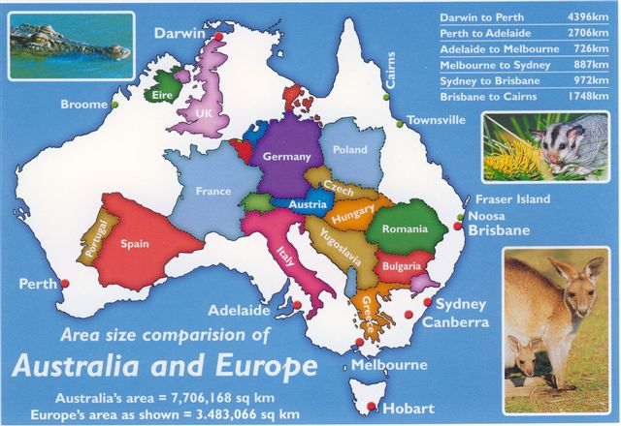
AUSTRALIA IS A HUGE ISLAND CONTINENT
AUSTRALIA and EUROPE size comparison
Allow plenty of time to travel and enjoy this wonderful country.

Slide 10
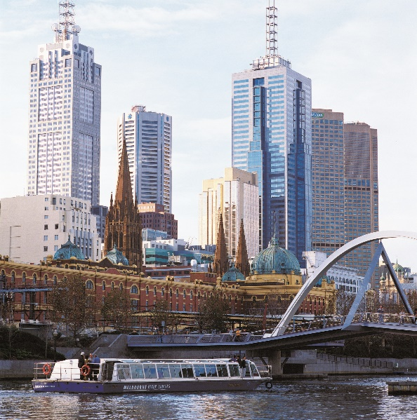
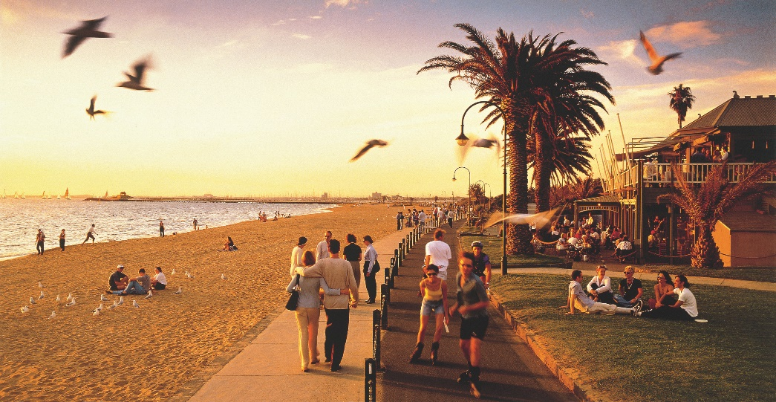
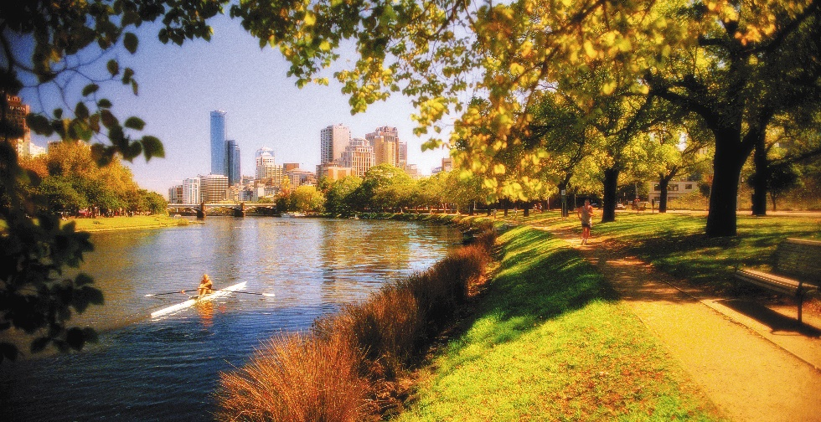
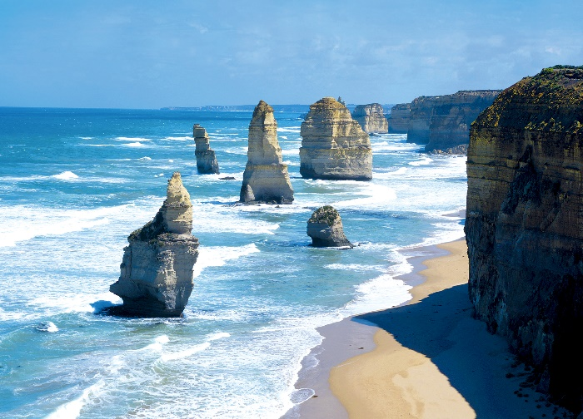
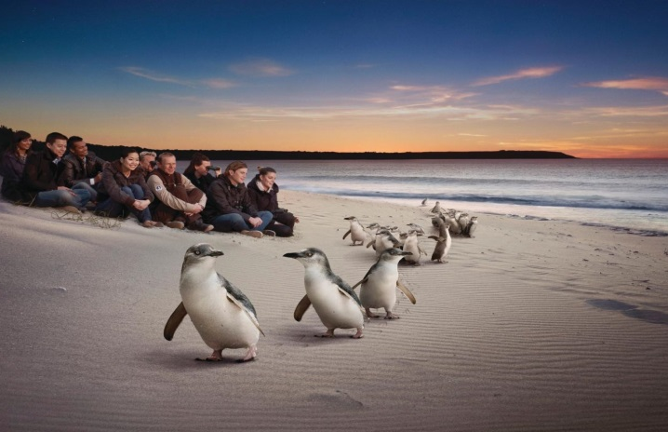
A wide variety of half and full day trips and PRE and POST convention tours
Many will offer meet and greet by Inner Wheel Australia members along the way.

Slide 11
AN EARLY MORNING HOT AIR BALLOON FLIGHT MELBOURNE

Slide 12
LOVE GOLF?
Val Gibson is organising a fun day out for golfing enthusiasts.

Slide 13
USEFUL WEBSITES
www.mcec.com.au
www.visitmelbourne.com
www.visitvictoria.com
www.australia.com

Slide 14
Melbourne Vacation Travel Guides Expedia
https://www.youtube.com/watch?v=RLOsQViPLhw
Well worth a look!

Slide 15
www.iiwconvention2018.com

Slide 16
11th – 14th April 2018
CONTACT:
IIW 2018 Convention Coordinator valcorva@bigpond.com
Convention Secretariat
ICMS Australasia Pty Ltd PO Box 5005 South Melbourne VIC 3205, Australia
P: (+61 3) 9682 0500 F: (+61 3) 9682 0344
www.icmsaust.com.au

